Slide 1
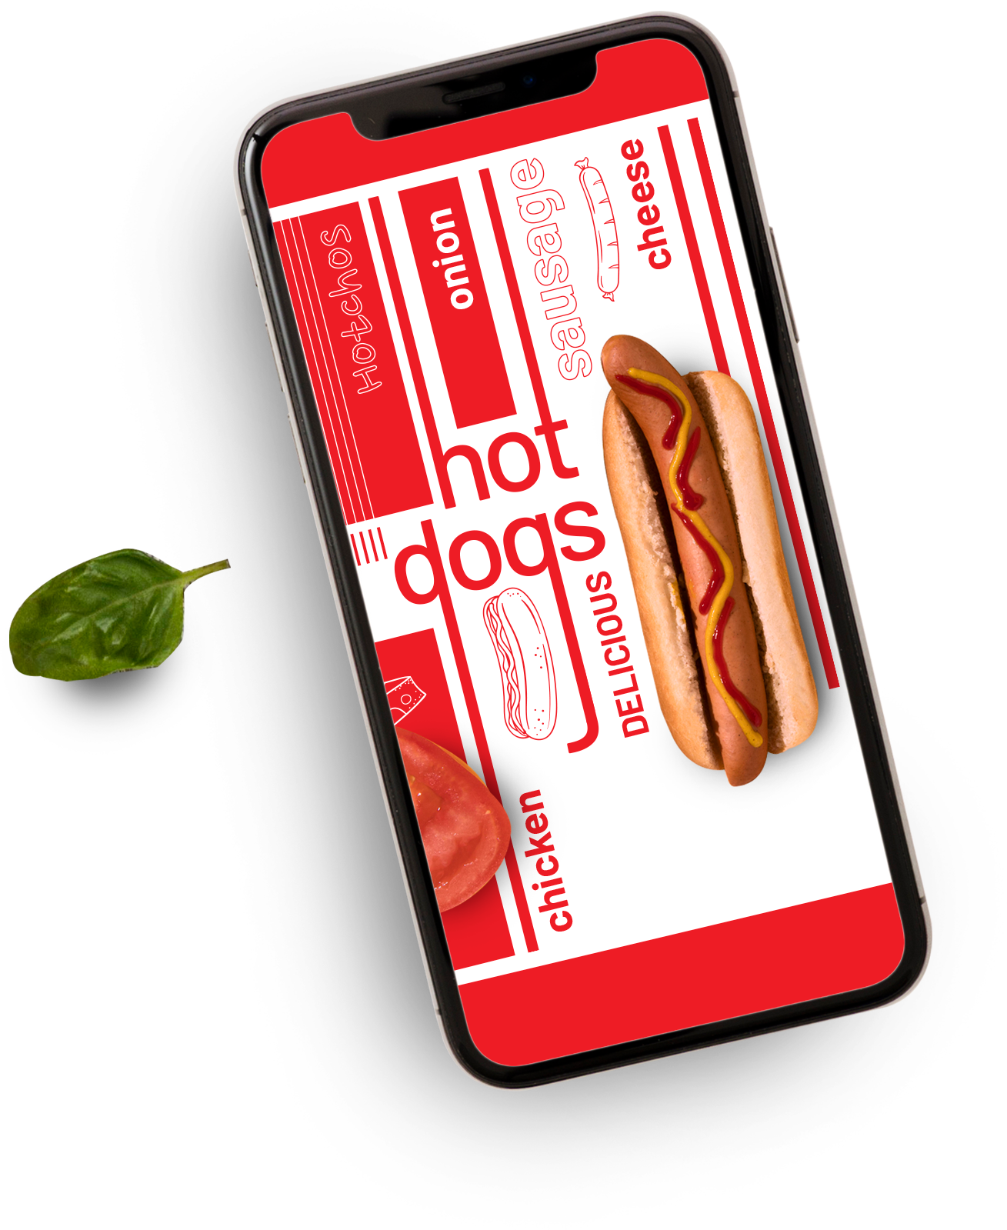





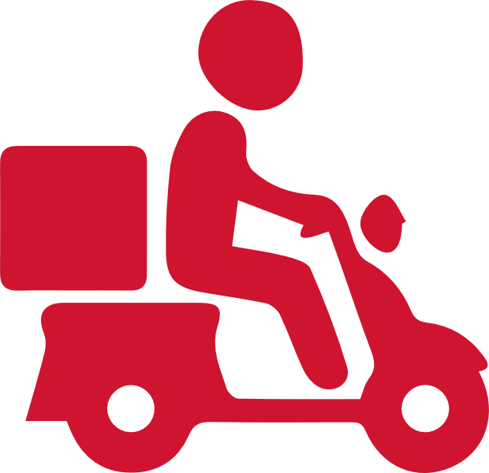


Zomato Orders & Restaurants Analysis Summary
Presentation by:
Thambidurai Sundaramoorthy
Home Delivery

Slide 2



Introduction
Domain
Zomato is a global restaurant discovery, food delivery, and dining services platform that connects users with restaurants in their area. It provides restaurant reviews, ratings, menus, and online ordering services across multiple countries. Founded in 2008, Zomato has expanded into food delivery, table reservations, and subscription-based dining programs like Zomato Pro.
Project
Analyze and visualize Zomato’s restaurant and order data to uncover trends in customer preferences, restaurant performance, pricing impact, and location-based insights. The goal is to transform raw data into actionable business intelligence for decision-making.

Slide 3
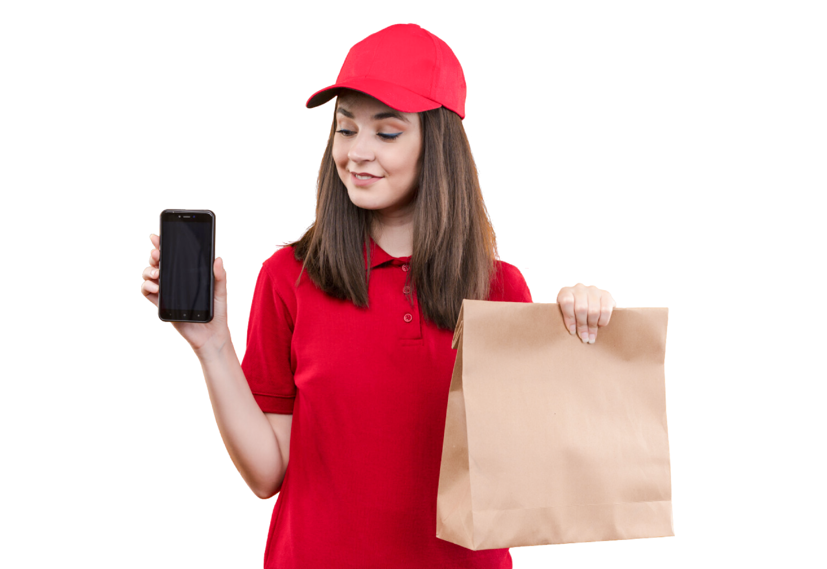
Objective
Business Use Cases:
To identify top-performing restaurants based on ratings and order volume.
To analyze how pricing impacts customer orders.
To understand customer preferences in different cities and areas.
To optimize delivery times and to improve efficiency
To forecast demand trends for future growth.

Slide 4

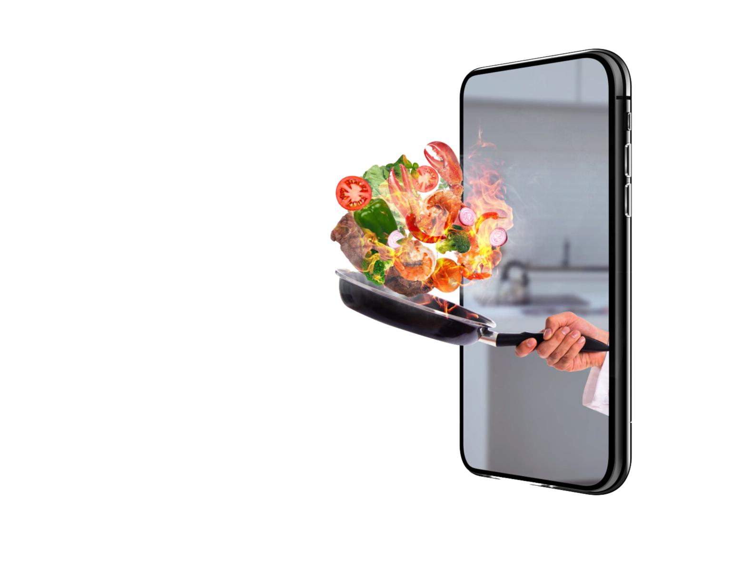






Overview
11.95M
15K
20
Total Revenue
Total Orders
Total Unique Restaurants
10
50
15K
Total Cities
Total Areas
Total Restaurants

Slide 5
SQL Task Summary
Task 1
Task 2
Upload Dataset into MySQL
1.1 -Basic Data Cleaning
Created a database ZomatoDB in MySQL.
Created and imported 2 csv table datasets in the name of Zomato_Restaurants and Zomato_Orders .
Removed duplicate records using the SQL query.
Verified NULL values from the dataset in MySQL and no NULL values found to replace.
Task 4
Task 5
Data Joins
Export the transformed dataset
Joined both the tables to get the restaurant names along with the order details using MySQL query.
Exported the transformed dataset tables from MySQL as an Excel file by saving it locally.

Slide 6
SQL Task Summary
Task 2
Task 2
Task 2
1.1 - Data Exploration Queries
1.2- Data Exploration Queries
1.3- Data Exploration Queries
Count the number of restaurants in each city
Find the top 5 cities with the highest number of orders
Calculate total revenue generated by each restaurant.
The top 10 restaurants in terms of sales have been displayed in the below table.
City | No. of Restaurants
Bangalore | 1531
Chennai | 1524
Hyderabad | 1517
Mumbai | 1506
Kolkata | 1502
Pune | 1494
Delhi | 1486
Ahmedabad | 1482
Jaipur | 1479
Lucknow | 1479
City | Total Orders
Bangalore | 1531
Chennai | 1524
Hyderabad | 1517
Mumbai | 1506
Kolkata | 1502
Restaurants | Total Sales
Street Food Hub | 658K
Royal Feast | 645K
South Spice | 636K
Lucknow Tandoori | 635K
North Indian Delight | 625K
Fusion Bites | 606K
Desi Tadka | 606K
Mumbai Masala | 599K
Jaipur Jalebi | 595K
Delhi Diner | 592K

Slide 7
SQL Task Summary
Task 3
Task 3
1.2- Data Aggregation
1.1 - Data Aggregation
Find the average order amount for each city
Identify top 5 restaurants with the highest total sales
City | Avg. Order Amount
Kolkata | 811.79
Lucknow | 806.64
Pune | 800.82
Bangalore | 800.59
Mumbai | 800.176
Hyderabad | 790.94
Delhi | 790.73
Ahmedabad | 790.62
Chennai | 788.63
Jaipur | 785.95
City | Total Sales
Street Food Hub | 6,58,502/-
Royal Feast | 6,45,804/-
South Spice | 6,36,691/-
Lucknow Tandoori | 6,35,200/-
North Indian Delight | 6,25,752/-

Slide 8
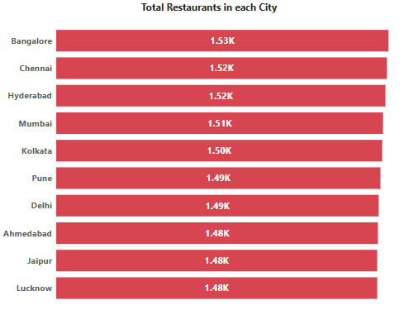
Power BI Task Summary
Task 1
Number of Restaurants per City
Bangalore city has the highest number of restaurants of 1531 where as Jaipur and Lucknow cities has the lowest number of restaurants of 1479 each respectively. City population is not available in the dataset to calculate the correlation.
City | No. of Restaurants
Bangalore | 1531
Chennai | 1524
Hyderabad | 1517
Mumbai | 1506
Kolkata | 1502
Pune | 1494
Delhi | 1486
Ahmedabad | 1482
Jaipur | 1479
Lucknow | 1479

Slide 9
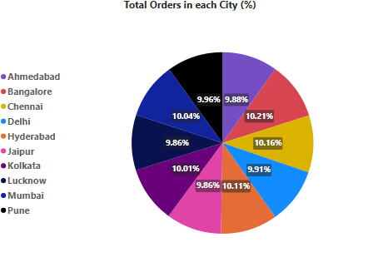
Power BI Task Summary
Task 2
% of Orders from Different Cities
Bangalore city dominated the Zomato market which has the highest % of orders of 10.21% where as Jaipur and Lucknow cities has the lowest number of orders of 9.86% each respectively. Each restaurants have 1 order each which means there is no imbalance.
City | No. of Orders | % of Orders
Bangalore | 1531 | 10.21%
Chennai | 1524 | 10.16%
Hyderabad | 1517 | 10.11%
Mumbai | 1506 | 10.04%
Kolkata | 1502 | 10.01%
Pune | 1494 | 9.96%
Delhi | 1486 | 9.91%
Ahmedabad | 1482 | 9.88%
Jaipur | 1479 | 9.86%
Lucknow | 1479 | 9.86%

Slide 10
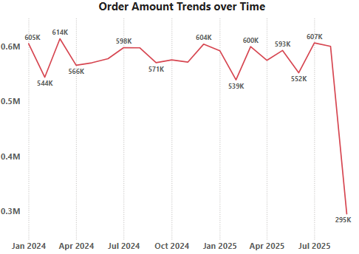
Power BI Task Summary
Task 3
Order Amount Trends Over Time
The highest sales occurred during the month of March where as lowest sales occurred during the month of September. There are some variations in the sales due to seasons. No sale happened during the Q4 in the year 2025.
Months | Total Sales (2024) | Total Sales (2025)
January | 605K | 592K
February | 544K | 539K
March | 614K | 599K
April | 566K | 574K
May | 570K | 592K
June | 577K | 552K
July | 598K | 606K
August | 597K | 600K
September | 570K | 295K
October | 575K | NA
November | 571K | NA
December | 604K | NA

Slide 11
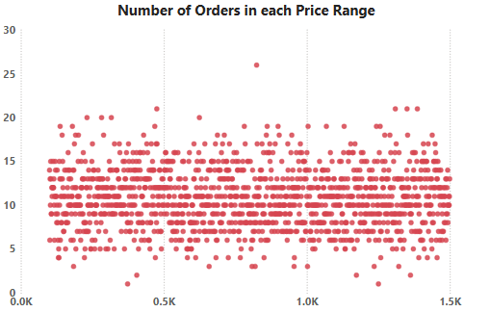
Power BI Task Summary
Task 4
Correlation of Factors Affecting Average Rating
The customer preference based on the ratings and delivery time can’t be predicted as no datasets are available.
The price ranges were between 100 to 1499. The order count on each price range has been plotted using the scatter plot.
The order amount of 824 have the highest orders count of 26 where as the order amount of 373 and 1250 have the lowest orders count of 1.
There is no negative trends on the order amount
There is no order impact due to higher pricing where the higher order amount even have more orders.

Slide 12
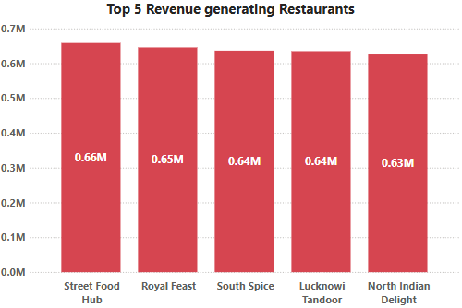
Power BI Task Summary
Task 5
Top 5 Restaurants by Total Sales
Street Food Hub restaurant generated the highest revenue of 0.66M which is 6,58,502/-. More number of branches makes these restaurants perform better than other restaurants in terms of revenue.
Restaurants | Total Sales | Total Branches
Street Food Hub | 6,58,502/- | 812
Royal Feast | 6,45,804/- | 798
South Spice | 6,36,691/- | 816
Lucknow Tandoori | 6,35,200/- | 766
North Indian Delight | 6,25,752/- | 782

Slide 13
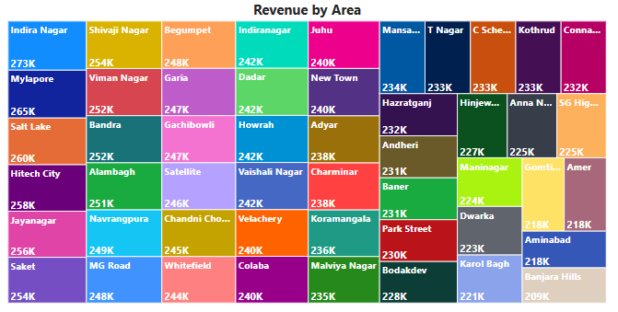
Power BI Task Summary
Task 6
Revenue by Area using a Tree Map
Indira Nagar from Lucknow has the highest revenue of 2,72,862/- where as Banjara Hills from Hyderabad has the lowest revenue of 2,09,453/-. The analysis proved that revenue is driven by high number of orders. Top 5 areas in terms of revenue, total orders and avg. order values are listed in the below table.
Area | Total Revenue
Indira Nagar | 272K
Mylapore | 265K
Salt Lake | 260K
Hitech City | 258K
Jayanagar | 256K
Area | Avg. Order Value
Indira Nagar | 837
Shivaji Nagar | 831.50
Indiranagar | 830.32
Navrangpura | 828.47
Chandni Chowk | 827.97
Area | Total Orders
Mylapore | 327
Indira Nagar | 326
Hitech City | 323
Saket | 321
Jayanagar | 318

Slide 14
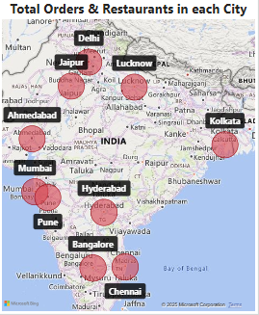
Power BI Task Summary
Task 7
Order Density by City using Heat Map
Bangalore city has the highest number of restaurants of 1531 where as Jaipur and Lucknow cities has the lowest number of restaurants of 1479 each respectively. Each restaurants receives exactly one order, indicating perfect balance between supply and demand.
City | Total Orders | Total Restaurants | Orders Per Restaurant
Bangalore | 1531 | 1531 | 1
Chennai | 1524 | 1524 | 1
Hyderabad | 1517 | 1517 | 1
Mumbai | 1506 | 1506 | 1
Kolkata | 1502 | 1502 | 1
Pune | 1494 | 1494 | 1
Delhi | 1486 | 1486 | 1
Ahmedabad | 1482 | 1482 | 1
Jaipur | 1479 | 1479 | 1
Lucknow | 1479 | 1479 | 1

Slide 15
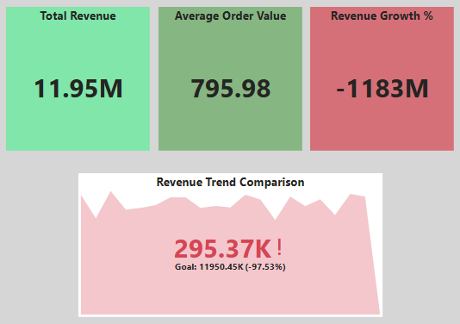
Power BI Task Summary
Task 8
KPI Cards – Total Revenue & Average Order Value
Using DAX Measure, the below-mentioned calculations have been done.
The average order value has been calculated by dividing the total revenue with the total orders which is found to be 795.98.
The Previous Period Revenue has been calculated to compare the current period revenue with previous period revenue.
The revenue growth % has been calculated to find the % increase or decrease in revenue.
Output:
The card visualization has been used to highlight the total revenue, average order value and revenue growth % with colors indicating green for positive and red for negative.
The KPI visualization has been used to display the revenue trend comparison to show the revenue progress with color indication. This trend indicator results in negative.

Slide 16
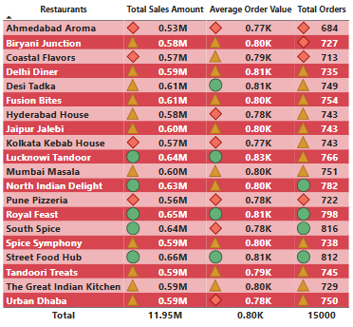
Power BI Task Summary
Task 9
Restaurant-Wise Sales Summary in a Table
The restaurant-wise summary of sales, avg. order value and total orders have been displayed by highlighting the best and worst-performing restaurants. The difference in color formatting in all columns are explained below.
The green color formatting is the best-performing restaurant.
The yellow color formatting is the mid-performing restaurant.
The red color formatting is the worst-performing restaurant.
This has been categorized by comparing with in the available restaurants.
The filtering through city, area and price range have been enabled in the dashboard.

Slide 17

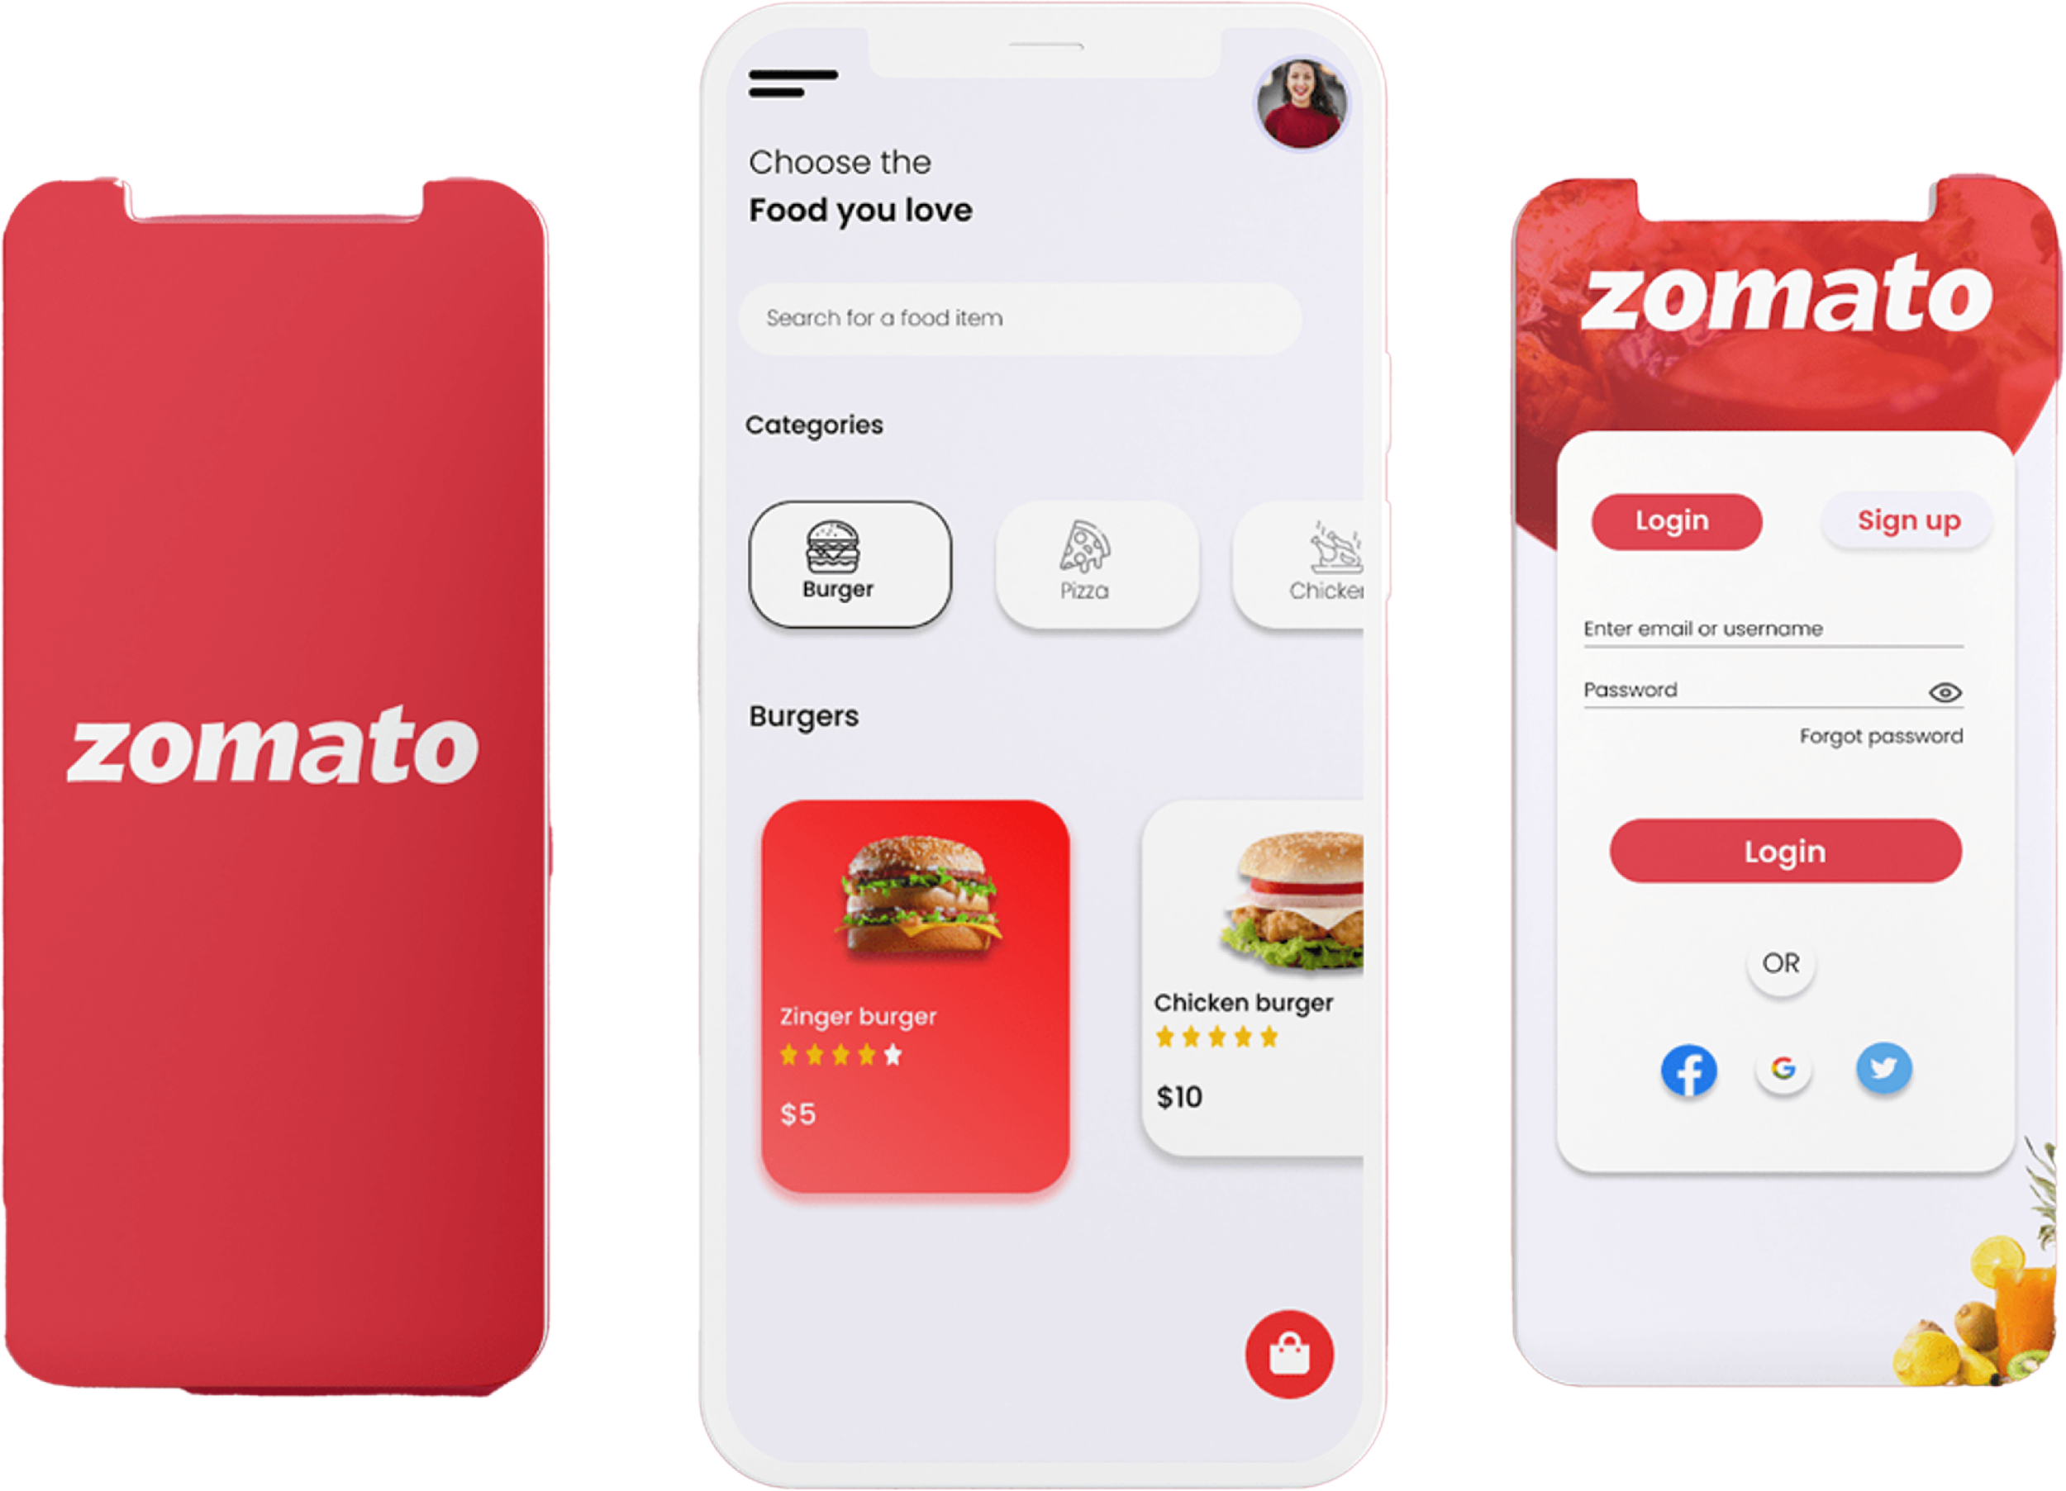
Business Insights
The top-performing restaurant in terms of revenue is Street Food Hub which generated the highest revenue of 658K.
Each restaurant received one order where as South Spice restaurant has the maximum branches of 816 and they tops the highest orders of 816.
Royal Feast restaurant has the branches of 103 in Hyderabad which is the highest number of branches for a restaurant in a particular city.
As each restaurant received one order, the preferences of the customers in cities and areas are equal where there is no imbalance from the customers perspective. Also, no impact on order because of pricing as well.
Some business use cases based on ratings, delivery time can’t be analyzed as no datasets available.
The forecasting demand trends for future growth depends on the restaurant management in terms of increasing their branches across different locations. The more number of branches will generate more revenue.

Slide 18

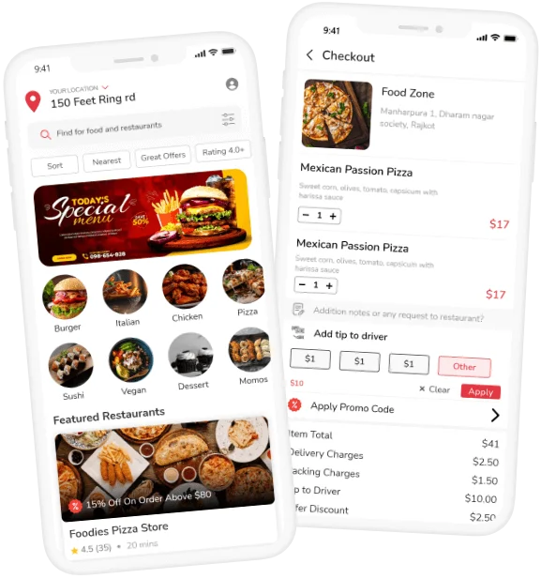

Thank You
Thambidurai Sundaramoorthy
stdurai95@gmail.com

